Slide 1

USE OF Large Language Model (LLM) IN HOSPITALITY & IN OTHER INDUSTRIES
By Pranjal Jain
AI/ML Engineer

Slide 2
AGENDA
WHAT IS LARGE LANGUAGE MODEL LLM?
LLM MODEL OVERVIEW
LLM BASICS WORKING FLOW
MAIN COMPONENTS OF → LLM MODEL
ARCHITECTURE OF → LLM MODEL
DIFFERENT WAY TO BUILD → LLM MODEL
DEMO → LLM MODEL
FINE TUNING -> LLM MODEL
APPLICATIONS OF LLMS
USE OF LLM IN HOSPITALITY
THE FUTURE OF LARGE LANGUAGE MODELS
COMPARISON WITH OTHER AI MODELS
CONCLUSION
FINAL TIPS & TAKEAWAYS

Slide 3
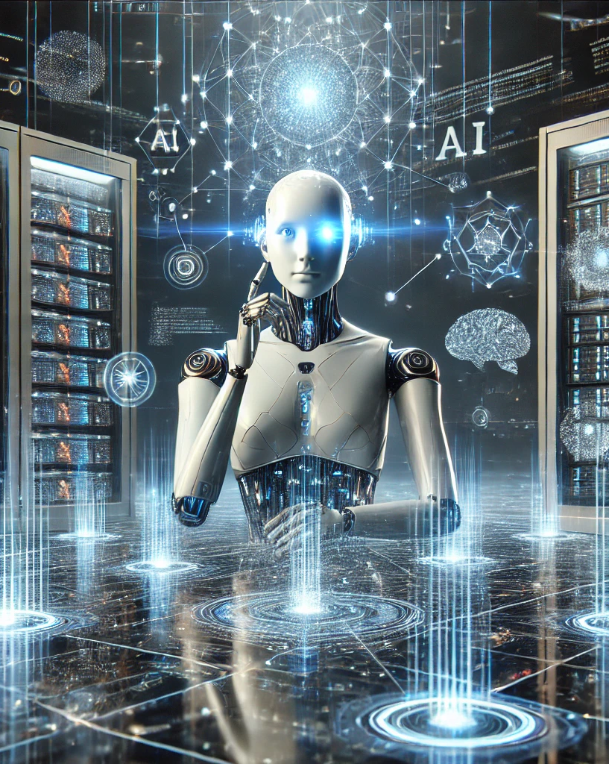
WHAT IS Large Language Model LLM?
Large Neural network trained at internet scale to estimate the probability of sequences of word.
An LLM is an AI model that uses deep learning to understand, generate, and manipulate human language.
Example:- GPT, LLaMA, PaLM, Gemini etc.

Slide 4
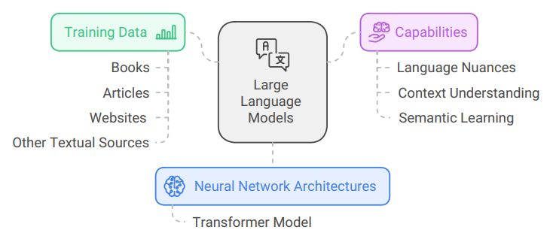
llm model overview

Slide 5
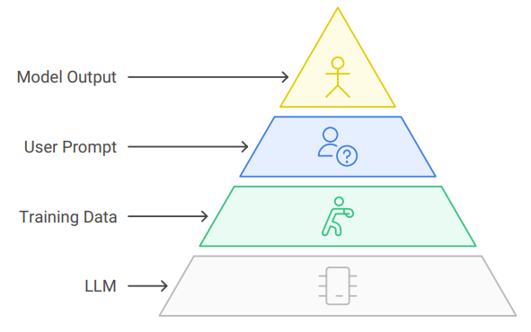
LLM basics Working flow

Slide 6
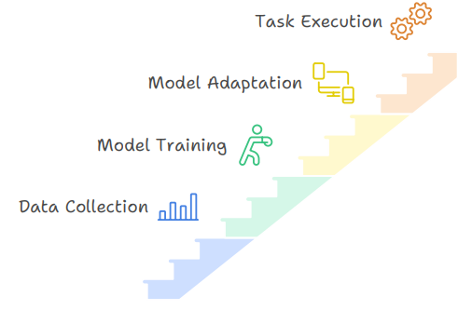
LLM BASICS WORKING FLOW

Slide 7
Main components of → llm model
Large Language Models (LLMs) are built on the Transformer architecture, which has proven to be highly effective for tasks related to natural language processing (NLP).
Transformers: The backbone of most LLMs, transformers utilize self-attention mechanisms to weigh the importance of different words in a sentence, allowing the model to understand context and relationships between words effectively.
Tokenization: Before training, text data is broken down into smaller units called tokens. This process helps the model to handle various languages and formats more efficiently.
Embedding Layers: These layers convert tokens into numerical representations, enabling the model to process and understand the input data.
Layers and Parameters: LLMs consist of multiple layers, each containing numerous parameters that are adjusted during training to minimize prediction errors.

Slide 8
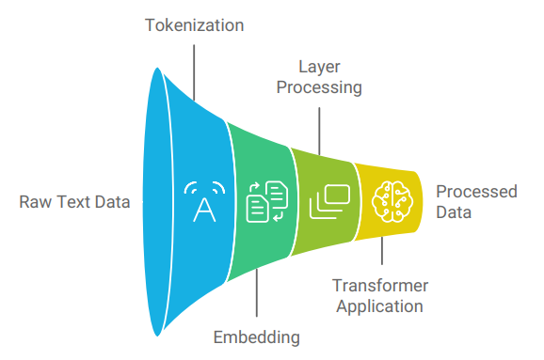
components of llm model

Slide 9
Architecture of → llm model
Model | Type | Key Characteristics | Use Cases
BERT | Encoder | Bidirectional, Masked Language Modeling (MLM) | Text classification, NER, QA
GPT-3 | Decoder | Unidirectional, Causal Language Modeling (CLM) | Text generation, Summarization
T5 | Encoder-Decoder | Sequence-to-sequence, Text-to-Text Transfer | Summarization, Translation, QA
BART | Encoder-Decoder | Pre-trained for denoising, sequence-to-sequence | Text generation, Translation
RoBERTa | Encoder | BERT with more data and longer training | Text classification, NER

Slide 10
Different way to build → llm model
Prompt Engineering :- Crafting prompts to guide pre-trained LLMs to produce specific responses. It’s quick and effective for many use cases without needing to train or fine-tune the model.
RAGs (Retrieval-Augmented Generation):- Combining LLMs with external knowledge sources (e.g., databases or search engines) to retrieve relevant information and generate more accurate and context-aware responses.
Fine-Tuning LLMs:- Adapting a pre-trained LLM to a specific task or domain by training it further on a smaller, task-specific dataset.
Training LLMs from Scratch:- Building a new LLM by training it on a large corpus of data from the ground up, allowing complete control over the architecture and training process

Slide 11
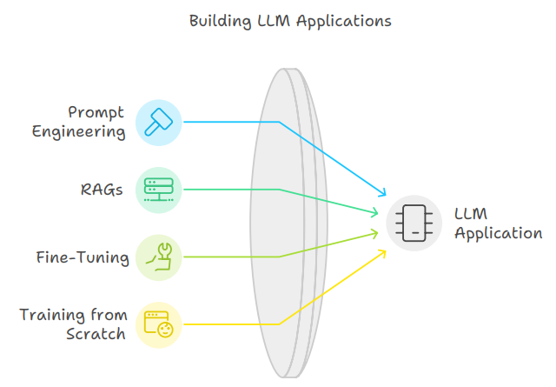
Different way to build → llm model

Slide 12
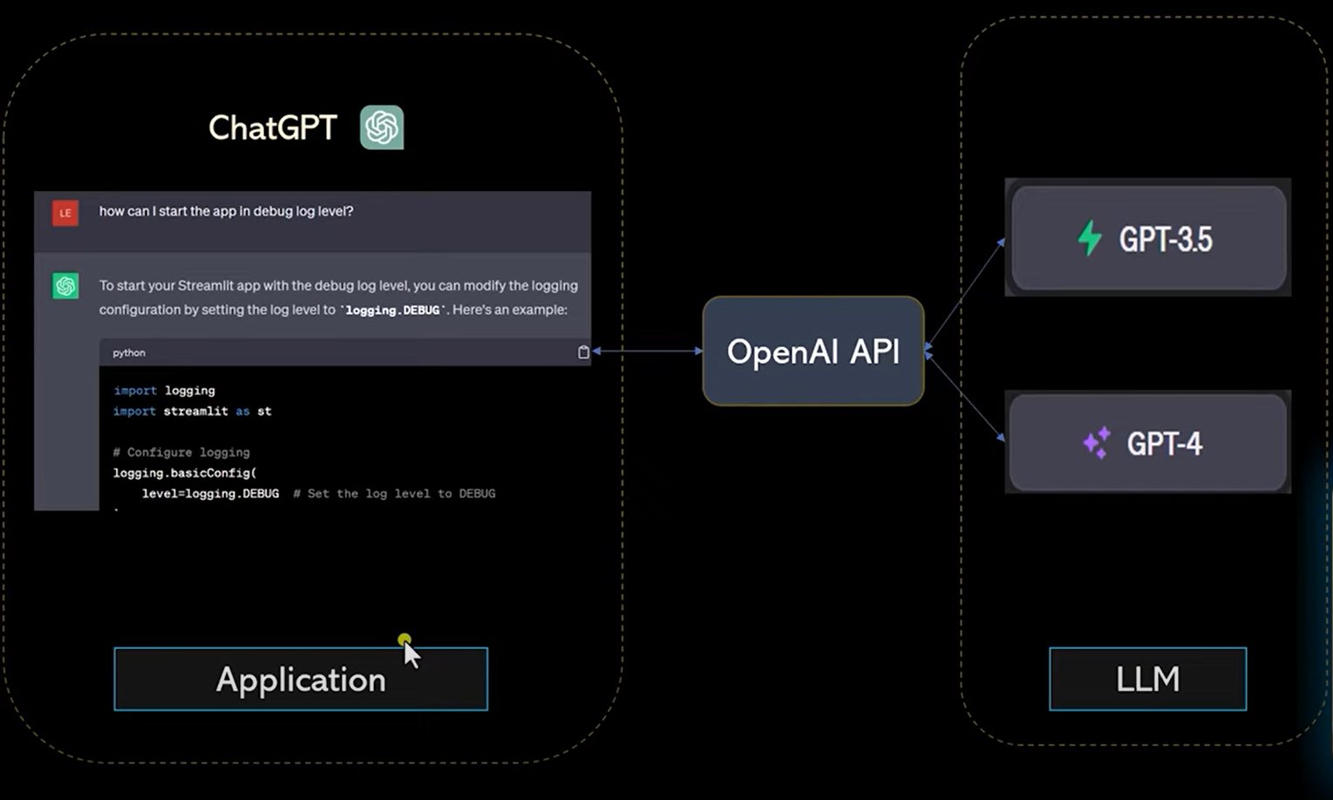
Navigating Q&A Sessions
Preparing for questions
Maintaining composure
Know your material in advance
Anticipate common questions
Rehearse your responses
Maintaining composure during the Q&A session is essential for projecting confidence and authority. Consider the following tips for staying composed:
Stay calm
Actively listen
Pause and reflect
Maintain eye contact

Slide 13
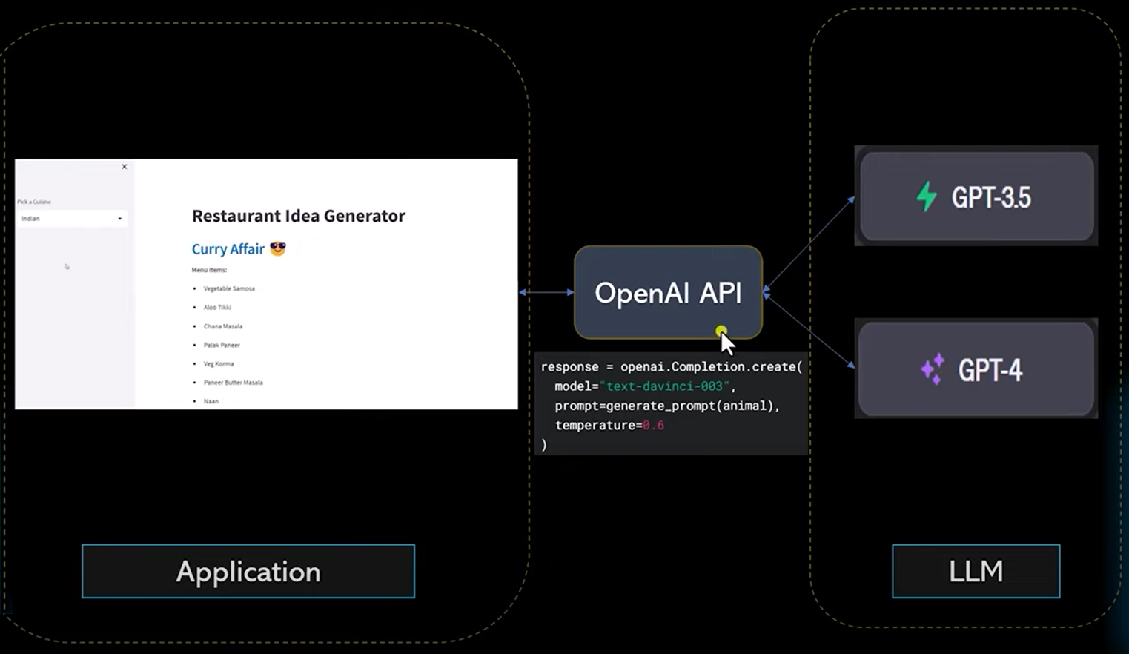

Slide 14
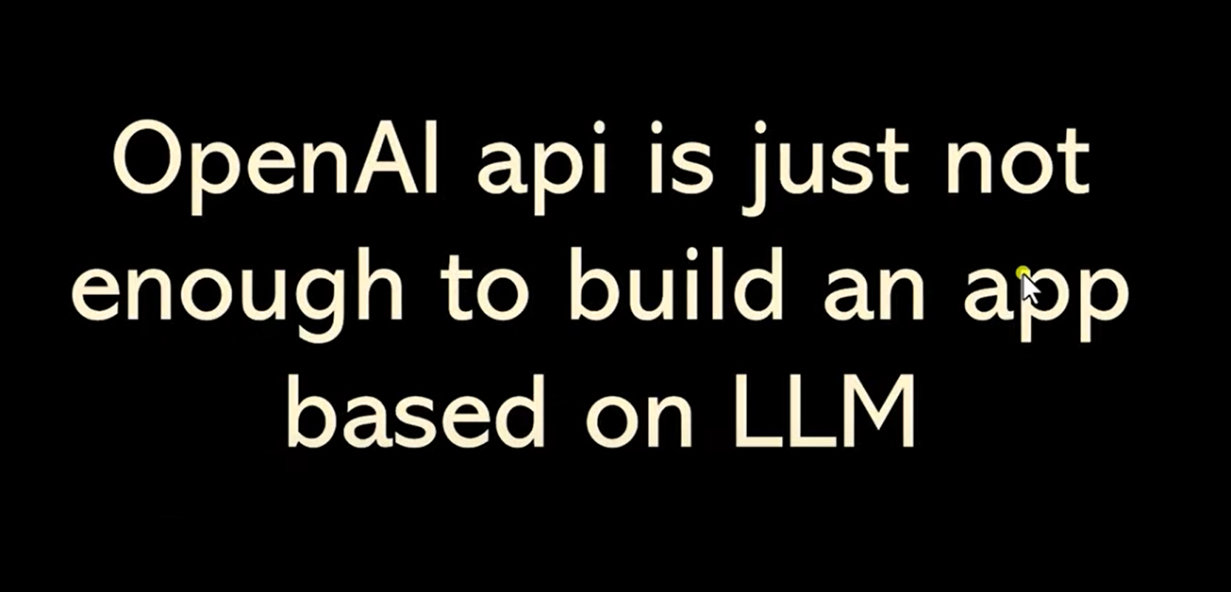

Slide 15
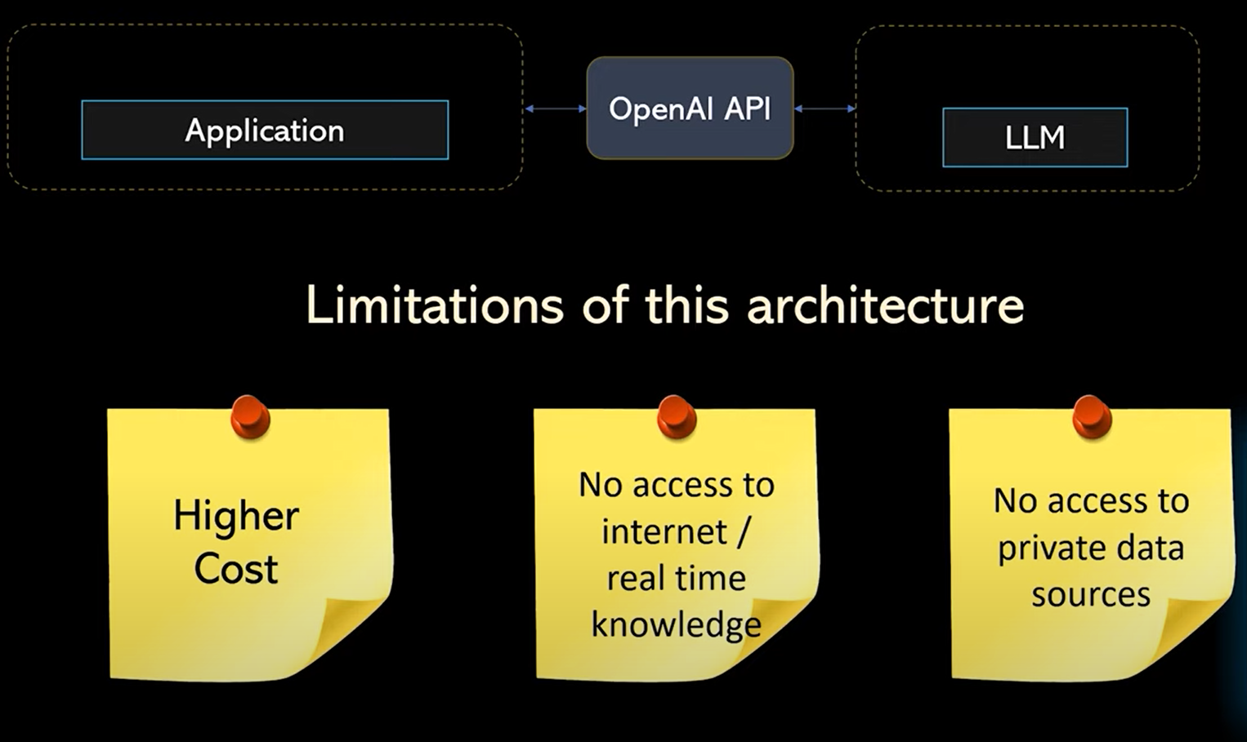

Slide 16
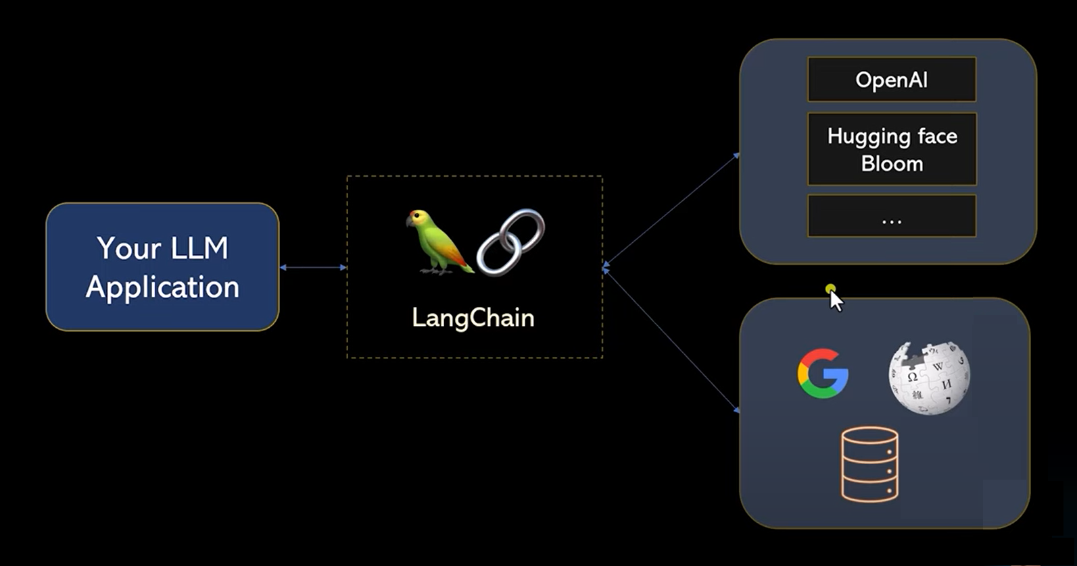
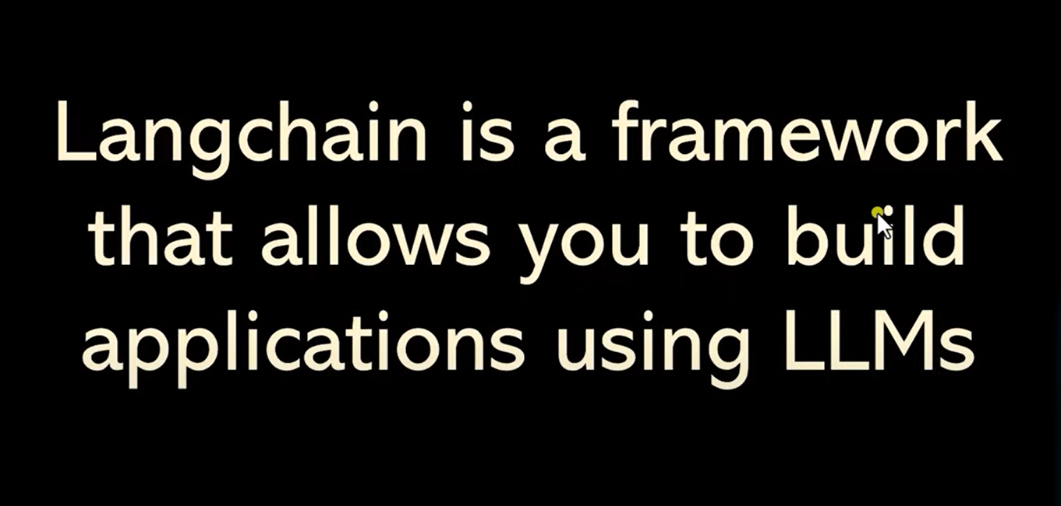

Slide 17
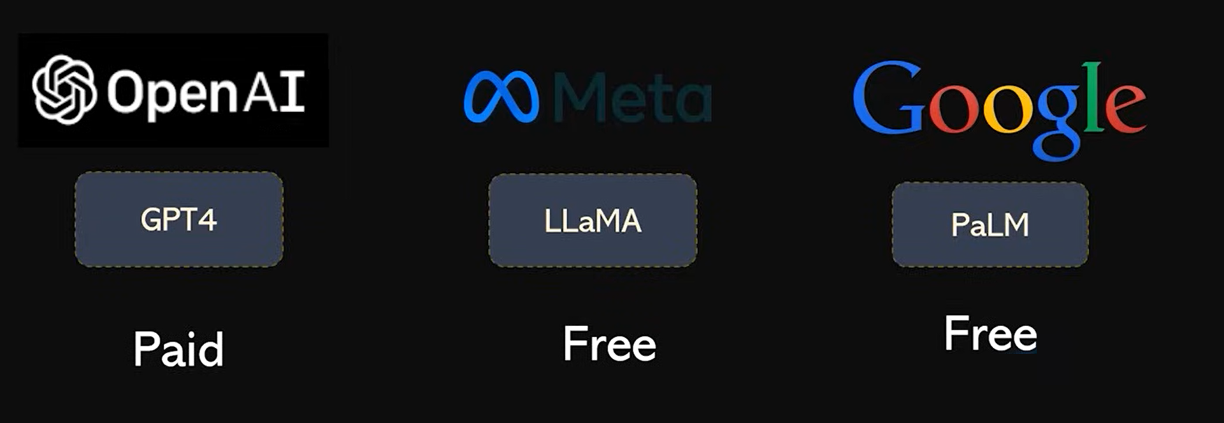

Slide 18
Demo → llm model
To get API of Gemini models
https://aistudio.google.com/app/apikey

Slide 19
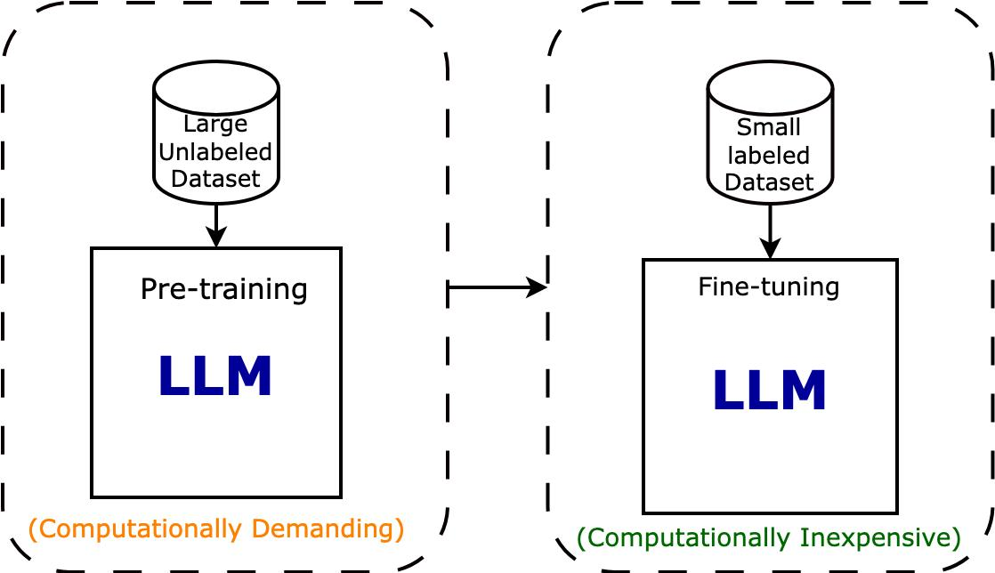
Fine Tuning -> llm model

Slide 20
Applications of LLMs
Text Generation: Creating human-like text for articles, blogs, etc.
Chatbots/Assistants: Powering virtual assistants (e.g., ChatGPT).
Translation: Real-time translation between languages.
Coding: Assisting in code generation (e.g., GitHub Copilot).
Summarization, Sentiment Analysis: Condensing long articles, analyzing emotions in text.

Slide 21
Use of llm in hospitality
1. Personalized Guest Communication
Chatbots: LLM-powered chatbots can assist guests in real-time, answering queries about hotel amenities, booking details. These chatbots provide 24/7 service, increasing guest satisfaction by ensuring immediate responses.
Email Responses: LLMs can be used to generate personalized emails or replies to guest inquiries or complaints, providing quick, detailed, and context-aware responses.
2. Data-Driven Insights
LLMs can analyze guest feedback from reviews, surveys, & social media to provide insights into areas for improvement.
Sentiment Analysis: LLMs can gauge the tone of customer reviews, helping hotels understand guest sentiment in real-time.
Trend Identification: LLMs can identify recurring issues or popular amenities, assisting hotels in adjusting their offerings accordingly.
3. Revenue Management & Demand Forecasting
LLMs can analyze historical data and market trends to help with demand forecasting, allowing hotels to optimize pricing strategies. But still we use LSTM model to predict the time series of data for the future.
By understanding guest preferences and market dynamics, hotels can increase revenue by adjusting room rates, packages, or promotions based on AI-driven insights.

Slide 22
The Future of Large Language Models
More efficient models (smaller, faster).
Improved multilingual capabilities.
Better alignment with human values.
Hybrid systems combining reasoning with language understanding.

Slide 23
Comparison with Other AI Models
LLMs vs Traditional ML Models:
More flexible in language understanding but less structured.
Require more data and compute but perform better in zero-shot settings.
LLMs vs Vision Models:
Specialize in language tasks vs vision-based tasks like image recognition.

Slide 24
Conclusion
Summary: LLMs are reshaping industries by pushing the boundaries of language understanding.
Call to Action: Explore how you can integrate LLMs into your own projects.
Final Thought: The ethical and societal implications must be considered as these models continue to evolve.

Slide 25
Final tips & takeaways
My Code link
https://github.com/4Pranjal/LLM-AI-Meetup/tree/main
Roadmap for Generative AI 2024
https://github.com/krishnaik06/Roadmap-To-Learn-Generative-AI-In-2024
Nvidia LLM model
https://build.nvidia.com/explore/discover
To implement LLAMA 3.1
https://www.youtube.com/watch?v=CO4E_9V6li0

Slide 26
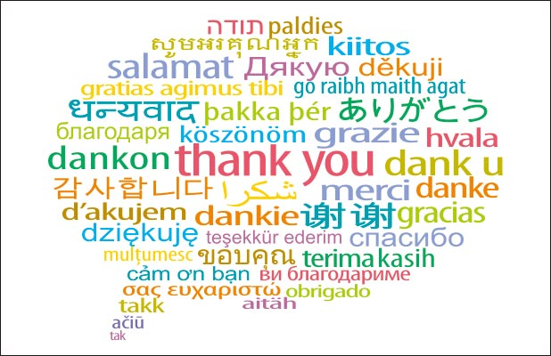

Slide 27
Questions…..??
Continue improving
Seek feedback
Practice makes perfect
Consistent rehearsal
Pranjal Jain
+34 643732556
Pranjal.jain43@gmail.com

